Slide 1
Single Table SQL
COMP 3421
Database Systems

Slide 2
Overview
Introduction to SQL
Single-table select queries
Using the DBMS to manipulate data output
Suppressing duplicates and sorting data
Performing arithmetic and string operations on data values
Formatting query output
Performing single-row functions on data values
Performing summary operations on groups of retrieved data

Slide 3
Introduction to SQL
Query: command to perform an operation on a database object
View
Create
Insert, Modify, Delete
Structured Query Language (SQL)
Standard declarative programming language designed to manage data in relational databases
Two commonly used DBMSs include Oracle and MySQL
Both include extensions to standard SQL functionality

Slide 4
Introduction to SQL
Data Definition Language (DDL)
Used to create and modify database objects
Data Manipulation Language (DML)
Used to insert, update, delete, and view the data in database objects
We'll start with DMLs for viewing data
Some syntax specific to Oracle and/or MySQL

Slide 5
Overview
Introduction to SQL
Single-table select queries
Using the DBMS to manipulate data output

Slide 6
Retrieving Data From a Single Table
Examples of DML for viewing data in a single table
SELECT column1, column2, …
FROM schema.tablename
WHERE search_condition
SELECT cust_id, cust_name
FROM COMP3421.candy_customer
WHERE cust_id = 1

Slide 7
Retrieving Data From a Single Table
If you are logged on to the schema that contains the table, you can omit the schema (user) name…`
SELECT cust_id, cust_name
FROM COMP3421.candy_customer
WHERE cust_id = 1
SELECT cust_id, cust_name
FROM candy_customer
WHERE cust_id = 1

Slide 8
Retrieving All Fields or Records
To retrieve all fields in the table: use the "*" wildcard character
To retrieve all records in a table: omit the where component
SELECT *
FROM tablename
WHERE search_condition

Slide 9
Search Conditions
Format
WHERE fieldname operator expression
Operators
Equal (=)
Greater than, Less than (>, <)
Greater than or Equal to (>=)
Less than or Equal to (<=)
Not equal (< >, !=, ^=)
LIKE
BETWEEN
IN
NOT IN

Slide 10
Search Conditions
Examples
WHERE s_name = 'Sarah'
WHERE s_age > 18
WHERE s_class <> 'SR'
WHERE cust_addr LIKE '%St%'
WHERE s_age BETWEEN 18 AND 25
WHERE s_class IN ('SR', 'JR')
Oracle - text in single quotes is case sensitive
MySQL - text in single quotes is NOT case sensitive

Slide 11
MySQL Case Sensitive Search
SELECT cust_name FROM candy_customer WHERE BINARY cust_name LIKE '%ca%'
Returns nothing (doesn't find 'The Candy Kid')
Binary string comparisons compare numeric byte values
If either side of operator (LIKE, =, <, etc.) is binary, then a binary (case sensitive) comparison is used

Slide 12
Search Conditions (continued)
Numerical literals
Just specify the value (no additional syntax)
Example
WHERE pounds = 5
String literals
Surround the value in single quotes
Example
WHERE status = 'PAID’
Be sure to mind the case-sensitivity

Slide 13
Search Conditions
Dates
Date literals
Oracle: ‘DD-MON-YY’ (‘25-AUG-14’)
MySQL: ‘YYYY-MM-DD’ (‘2014-08-25’)
Date values may be compared using most of the previously specified operators
Oracle dates consist of a date and timestamp
Mind the timestamp when checking for equality
MySQL dates consist of a date only
A variety of literal specifications and date related functions will be addressed throughout this and subsequent lectures

Slide 14
Search Conditions
Partial-text search
Use the LIKE operator and the % wildcard character
% matches 0 or more characters
% can be used before and/or after a string literal
Examples
WHERE cust_zip LIKE '912%'
WHERE cust_name LIKE '%s'
WHERE cust_name LIKE '%s%'

Slide 15
Search Conditions
Which CUST_ID records will the following query retrieve?
SELECT cust_id
FROM candy_customer
WHERE cust_name LIKE '%s%'
1, 3, 4, 7, 8, 10
1, 2, 3, 4, 7, 8, 9, 10
1, 2, 3, 4, 7, 8, 10
1, 3, 4, 7, 8, 9, 10
None of the above

Slide 16
Searching for NULL Values
NULL: undefined
Search conditions for NULL and non-NULL values:
WHERE column_name IS NULL
WHERE column_name IS NOT NULL

Slide 17
Combining Multiple Search Conditions
AND: query only retrieves records for which both conditions are true
WHERE Condition1 AND Condition2
OR: query retrieves records for which either condition is true
WHERE Condition1 OR Condition2
Evaluates AND comparisons first, then evaluates OR comparisons

Slide 18
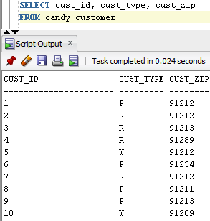
Combining Multiple Search Conditions
Which CUST_ID records will the following query retrieve?
SELECT cust_id
FROM candy_customer
WHERE cust_type = 'W'
AND cust_zip = '91209'
OR cust_zip = '91212'
10
5
5, 10
1, 2, 5, 7, 10
None of the above

Slide 19
Order of Evaluation
To force a specific evaluation order, place conditions to be evaluated first in parentheses
SELECT cust_id
FROM candy_customer
WHERE cust_type = 'W'
AND (cust_zip = '91209'
OR cust_zip = '91212')

Slide 20
Overview
Introduction to SQL
Single-table SELECT queries
Using the DBMS to manipulate data output
Suppressing duplicates and sorting data
Performing arithmetic and string operations on data values
Formatting query output
Performing single-row functions on data values
Performing summary operations on groups of retrieved data

Slide 21
Suppressing Duplicate Outputs
Use the DISTINCT qualifier
SELECT DISTINCT cust_zip
FROM candy_customer;

Slide 22
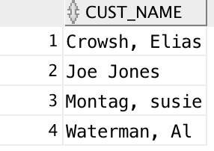
Sorting Query Output
Use the ORDER BY clause
Always appears as the last item in a SELECT query
SELECT cust_name
FROM candy_customer
WHERE cust_type = 'P'
ORDER BY cust_name;

Slide 23
Sorting Query Output
Default sort order is ascending
Numbers: smallest to largest
Characters: alphabetical
Dates: oldest to newest
To force a descending sort order, add the DESC modifier
SELECT purch_id, purch_date
FROM candy_purchase
ORDER BY purch_date DESC

Slide 24
Multiple Sort Keys
You can sort output by multiple keys
Only makes sense when the first sort key has repeating values…
SELECT purch_id, purch_date
FROM candy_purchase
ORDER BY purch_date DESC, purch_id

Slide 25
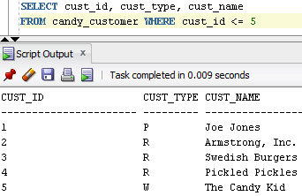
Multiple Sort Keys
In what order does this query retrieve CUST_ID values?
SELECT cust_id
FROM candy_customer
WHERE cust_id <= 5
ORDER BY cust_type DESC, cust_name
5, 2, 4, 3, 1
5, 2, 3, 4, 1
1, 2, 4, 3, 5
None of the above

Slide 26
Arithmetic Calculations in Queries
Often, applications perform arithmetic operations on retrieved data
You can perform basic arithmetic operations on numbers and dates in a SQL query SELECT clause
SELECT prod_desc, prod_price – prod_cost
FROM candy_product;

Slide 27
Arithmetic Operations on Number Data
Operators: +, -, *, /
Order of evaluation:
( )
*, /
+, -

Slide 28
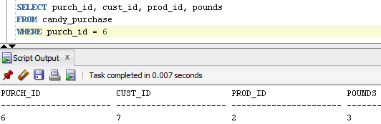
Arithmetic Operations on Number Data
SELECT (purch_id + cust_id)/prod_id - pounds
FROM candy_purchase
WHERE purch_id = 6
What does this query return?
3.5
2.5
-13
None of the above

Slide 29
Arithmetic Operations on Date Data
To retrieve a date that is a specific number of days from a known date, add/subtract the number of days
SELECT purch_id, purch_date, purch_date + 2
FROM candy_purchase;
SELECT purch_id, purch_date, purch_date – 2
FROM candy_purchase;

Slide 30
Arithmetic Operations on Date Data
To calculate the number of days between two known dates, subtract the dates
MySQL also has a DATEDIFF(<date>,<date>) function for this purpose
SELECT purch_id, purch_date,
delivery_date,
delivery_date - purch_date
FROM candy_purchase;

Slide 31
Retrieving the Current Date
Oracle
Use the SYSDATE pseudo column to obtain the current date
Pseudo column: command that acts like a column in a SQL statement
SELECT purch_id, SYSDATE - purch_date
FROM candy_purchase
WHERE delivery_date IS NULL;

Slide 32
Retrieving the Current Date
MySQL
Use the CURDATE() function to obtain the current date
SELECT purch_id, DATEDIFF(CURDATE(), purch_date)
FROM candy_purchase
WHERE delivery_date IS NULL;

Slide 33

Calculating Age
Oracle functions
MONTHS_BETWEEN
Returns the number of months, including the decimal fractions, between two dates
TRUNC
Removes all digits from a number beyond the specified precision (truncates all of the fractional part if the precision parameter is omitted)
Example
SELECT s_last, s_first,
(TRUNC(MONTHS_BETWEEN(SYSDATE, s_dob) / 12)) AS AGE
FROM nw_student;

Slide 34

Calculating Age
MySQL
YEAR function returns the year component of the date
RIGHT function returns the rightmost N digits
Calculating age example: RIGHT is used to examine the 5 digits representing the MM-DD part of the date
The part of the expression comparing the MM-DD of CURDATE to the MM-DD of s_dob evaluates to 1 or 0, which adjusts the year difference down a year if CURDATE() occurs earlier in the year than s_dob
1985-07-14
SELECT s_last, s_first,
(YEAR(CURDATE())-YEAR(s_dob)) - (RIGHT(CURDATE(),5) < RIGHT(s_dob,5)) AS age
FROM nw_student;

Slide 35
Storing Calculated Values
Commonly calculated data values
Peoples' ages
Total order amounts
Order commissions
In general, don’t store calculated values unless they are costly to determine or are needed for historical purposes

Slide 36
Overview
Introduction to SQL
Single-table SELECT queries
Using the DBMS to manipulate data output
Suppressing duplicates and sorting data
Performing arithmetic and string operations on data values
Formatting query output
Performing single-row functions on data values
Performing summary operations on groups of retrieved data

Slide 37
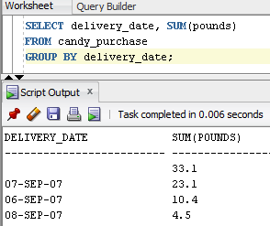
Default Query Output
Returned column names are database field names
Returned column names for calculations are the formula
By default, Oracle will truncate returned value decimal places (not MySQL)
Default date format
Oracle: DD-MON-YY
MySQL: YYYY-MM-DD

Slide 38
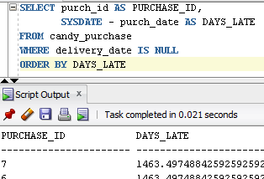
Column Aliases
Provides a temporary name for a database column in a query
Can't include spaces
i.e. “DAYS LATE” column alias would cause an error
What good are they?
You can use them in calculations and the ORDER BY clause
You can reference them in embedded programs

Slide 39


Modifying Date and Number Output Formats
Oracle
Use the TO_CHAR function
Format: TO_CHAR(value, 'format_mask')
SELECT purch_id,
TO_CHAR(purch_date, 'MM/DD/YYYY’)
FROM candy_purchase
SELECT prod_desc, TO_CHAR(prod_cost, '$99.99')
FROM candy_product

Slide 40

Concatenating Data Values
Oracle
Concatenation operator: ||
Example
SELECT cust_name, cust_addr || ' ' || cust_zip
FROM candy_customer;

Slide 41

Concatenating Data Values
MySQL
Concatenation function: CONCAT()
Example
SELECT cust_name, CONCAT(cust_addr, ' ', cust_zip)
FROM candy_customer;

Slide 42
Overview
Introduction to SQL
Single-table SELECT queries
Using the DBMS to manipulate data output
Suppressing duplicates and sorting data
Performing arithmetic and string operations on data values
Formatting query output
Performing single-row functions on data values
Performing summary operations on groups of retrieved data

Slide 43
Single-Row Functions
Operates on a single retrieved data value
General syntax
SELECT function(fieldname)
FROM tablename
WHERE...

Slide 44
Oracle SQL Number Functions
Function | Description | Example Query | Result
ABS(number) | Returns the absolute value of a number | SELECT ABS(capacity) FROM location WHERE loc_id = 45; | ABS(150) = 150
CEIL(number) | Returns the value of a number, rounded up to the next highest integer | SELECT CEIL(price) FROM inventory WHERE inv_id = 11668; | CEIL(259.99) = 260
FLOOR(number) | Returns the value of a number, rounded down to the next integer | SELECT FLOOR(price) FROM inventory WHERE inv_id = 11668; | FLOOR(259.99) = 259
MOD(number, divisor) | Returns the remainder (modulus) for a number and its divisor | SELECT MOD(qoh, 10) FROM inventory WHERE inv_id = 11668; | MOD(16,10) = 6
POWER(number, power) | Returns the value representing a number raised to the specified power | SELECT POWER(QOH, 2) FROM inventory WHERE inv_id = 11669; | POWER(12, 2) = 144

Slide 45
Oracle SQL Number Functions
Function | Description | Example Query | Result
ROUND(<number>, <precision>) | Returns a number, rounded to the specified precision | SELECT ROUND(price, 0) FROM inventory WHERE inv_id = 11668; | ROUND(259.99,0) = 260
SIGN(<number>) | Identifies if a number is positive or negative by returning 1 if the value is positive, -1 if the value is negative, or 0 if the value is 0 | SELECT SIGN(qoh) FROM inventory WHERE inv_id = 11668; | SIGN(16) = 1
SQRT(n) | Returns the square root of n | SELECT SQRT(qoh) FROM inventory WHERE inv_id = 11668; | SQRT(16) = 4
TRUNC(n, precision) | Returns n truncated to the specified precision, where all digits beyond the specified precision are removed. If precision is omitted it defaults to 0. | SELECT TRUNC(price, 1) FROM inventory WHERE inv_id = 11668; | TRUNC(259.99,1) = 259.9

Slide 46
Oracle SQL Character Functions
Function | Description | Example Query | String Used in Function | Function Result
CONCAT(<string1>, <string2>) | Concatenates (joins) two strings | SELECT CONCAT(f_last, f_rank) FROM faculty WHERE f_id = 1; | 'Cox' and 'ASSO' | 'CoxASSO'
INITCAP(<string>) | Returns the string, with the initial letter only in upper case | SELECT INITCAP(bldg_code) FROM location WHERE loc_id = 45; | 'CR' | 'Cr'
LENGTH(<string>) | Returns an integer representing the string length | SELECT LENGTH(meth_pmt) FROM cust_order WHERE order_id = 1057; | 'CC' | 2
LPAD(<string>, <number of characters to add>, <padding character>), RPAD(<string>, <total length of return value>, <padding character>) | Returns the value of the string, with sufficient padding characters added to the left/right edge so return value equals total length specified | SELECT LPAD(meth_pmt, 5, '*'), RPAD(meth_pmt, 5, '*') FROM cust_order WHERE order_id = 1057; | 'CC' | ***CC CC***

Slide 47
Oracle SQL Character Functions
Function | Description | Example Query | String Used in Function | Function Result
LTRIM(<string>, <search string>), RTRIM(<string>, <search string>) | Returns the string with all occurrences of the search string characters trimmed on the left/right side. The order of the search string characters does not matter. | SELECT LTRIM(call_id, 'CS ') FROM course WHERE course_id = 1; | 'CS 101' | '101'
REPLACE(<string>, <search string>, <replacement string>) | Returns the string with every occurrence of the search string replaced with the replacement string | SELECT REPLACE(term_desc, '200', '199') FROM term WHERE term_id = 1; | 'Fall 2009' | 'Fall 1999'
SUBSTR(<string>, <start position>, <length>) | Returns a substring of the specified string, starting at the start position, and of the specified length | SELECT SUBSTR(term_desc, 1, 4) FROM term WHERE term_id = 1; | 'Fall 2009' | 'Fall'
UPPER(<string>), LOWER(<string>) | Returns the string, with all characters converted to upper/lower case | SELECT UPPER(term_desc) FROM term WHERE term_id = 1; | 'Fall 2009' | 'FALL 2009'

Slide 48
Oracle SQL Date Functions
Function | Description | Example Query | Return Value
ADD_MONTHS(<date>, <number of months to add>) | Returns a date that is the specified number of months after the input date | SELECT ADD_MONTHS(date_expected, 2) FROM shipment WHERE shipment_id = 211; | 9/15/2003
LAST_DAY(<date>) | Returns the date that is the last day of the month specified in the input date | SELECT LAST_DAY(date_expected) FROM shipment WHERE shipment_id = 211; | 9/30/2003
MONTHS_BETWEEN (<date1>, <date2>) | Returns the number of months, including decimal fractions, between 2 dates. If date1 is after date2, a positive number is returned, and if date1 is before date2, a negative number is returned. | SELECT MONTHS_BETWEEN (date_expected, TO_DATE('10-AUG-2003', 'DD-MON-YYYY')) FROM shipment WHERE shipment_id = 211; | 2.45

Slide 49
Overview
Introduction to SQL
Single-table SELECT queries
Using the DBMS to manipulate data output
Suppressing duplicates and sorting data
Performing arithmetic and string operations on data values
Formatting query output
Performing single-row functions on data values
Performing summary operations on groups of retrieved data

Slide 50
SQL Group Functions
Performs an operation on a field from a group of retrieved records
AVG (average of all retrieved values)
COUNT (number of records retrieved)
MAX (maximum value retrieved)
MIN (minimum value retrieved)
SUM (sum of all retrieved values)
These are standard SQL (not specific to Oracle)

Slide 51

SQL Group Functions
Examples
SELECT MAX(prod_cost), MIN(prod_cost),
AVG(prod_cost), SUM(prod_cost)
FROM candy_product
SELECT COUNT(*) FROM candy_customer

Slide 52
SUM and Statistical Functions
SUM, AVG, MAX, MIN
Can only be used with NUMBER columns
SUM(pounds)
MAX(prod_cost)
MIN(prod_cost)
AVG(prod_cost)

Slide 53
COUNT Function
Displays the number of records that a query will retrieve
Can be used on a column of any data type
Forms
COUNT(*) – displays total number of records, regardless if the record has fields that contain NULL values
COUNT(fieldname) – displays the number of retrieved records in which the specified field is NOT NULL

Slide 54
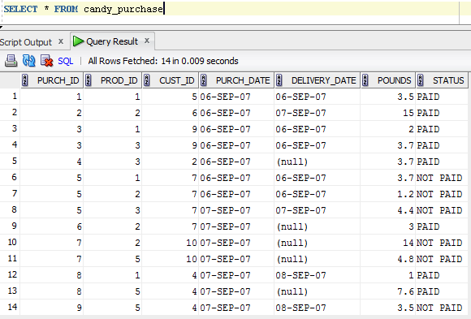
COUNT Function
What does the following query retrieve?
SELECT count(*)
FROM candy_purchase;
9
14
8
None of the above

Slide 55
COUNT Function
What does the following query retrieve?
SELECT count(delivery_date)
FROM candy_purchase;
9
14
8
None of the above

Slide 56
Using the GROUP BY Clause
Whenever you use a group function in a query, each column in the SELECT clause must either:
Involve a group function, or
Be listed in a GROUP BY clause
Equal field values for columns in the GROUP BY statement will be “grouped” as input for the group function(s) and will correspond to a single returned row
SELECT status, MAX(pounds)
FROM candy_purchase
GROUP BY status

Slide 57
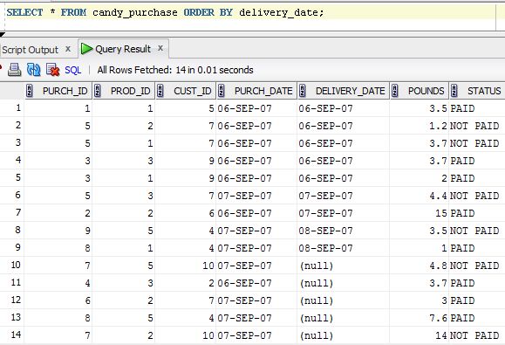
Using the GROUP BY Clause
What will the following query retrieve?
SELECT delivery_date, SUM(pounds)
FROM candy_purchase
GROUP BY delivery_date;
3 records
4 records
14 records
An error message

Slide 58
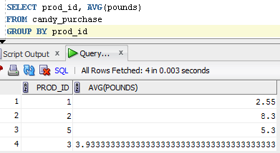

Using the HAVING Clause
Sometimes you want to use the result of a group function in a search condition
To do this, use HAVING instead of WHERE for the search condition involving the group function
A WHERE clause could still be present after the FROM clause for search conditions involving the non-group functions
SELECT prod_id, AVG(pounds)
FROM candy_purchase
GROUP BY prod_id
HAVING AVG(pounds) > 5

Slide 59
Using the HAVING Clause
If you use a group function in the HAVING clause and retrieve a non-group function value in the SELECT clause, you must group the output by the non-group function field
MySQL: HAVING clause MUST follow the GROUP BY clause
Oracle: HAVING can be either before or after the GROUP BY clause
SELECT prod_id
FROM candy_purchase
GROUP BY prod_id
HAVING AVG(pounds) > 5

